Slide 1


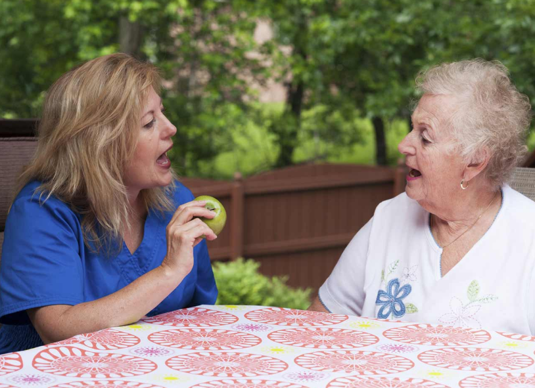
Deep Learning based classification approach to predicting Parkinson disease using distinctive features of audio

Slide 2
CONTENT
Parkinson’s Disease
Data Access
Model Building
Comparison between Deep learning and Traditional Models
Conclusion
Future Work
Objective
Research Question
Hypothesis
Literature Review
Library Dependencies

Slide 3
Parkinson’s Disease
Neurological Disorder
Symptoms

Slide 4
Objective
PET-CT image test
Test cost from $2,500 to 5,000
Expensive
Not all can afford
Machine Learning for predicting Parkinson’s disease
Vocal feature change is an earliest characteristic of Parkinson’s disease
Inexpensive
Affordable

Slide 5
Research Questions
Extraction of Audio features
Outperforming Algorithm
Scope of growth
Real time use

Slide 6
Hypothesis
Deep learning Algorithms outperforms over traditional algorithms
Findings during research: Deep Neural Network H2O among deep learning model works best

Slide 7
Literature Review
Fourteen Papers
Base paper (T. J. Wroge, 2018)
Take away from Literature Review
Small dataset thus less exposure to deep learning
Use large dataset and compare deep learning with traditional models
Compare models of deep learning with each others
Data Set : mPower
Features extracted 1200
Accuracy obtained from ANN model 86%
AUC 0.915
Features extracted 62
Accuracy obtained from ANN model 76%
AUC 0.823

Slide 8
Data Access Steps
Create Synapse Account
Become Certified user
Profile Validation
Data Access Request to mPower
Intend of data use statement
ACCEPT TERMS AND CONDITION

Slide 9

Data Distribution
Synapse contains 60000 audio records of 5826 people
30584 audio records used in research

Slide 10
Library Dependencies
Synapse Client
Pydub
PRAAT
Librosa

Slide 11
Deep Learning Models
Artificial Neural Network
Deep Neural Network (H2O)
Convolutional Neural Network

Slide 12
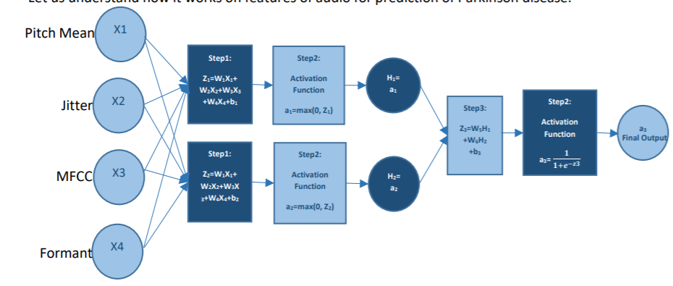
Artificial Neural Network

Slide 13
Deep Neural Network H2O
model= H2ODeepLearningEstimator(
hidden=[50,190,150],
activation = "tanh",
epochs = 10,
distribution="bernoulli",
loss='CrossEntropy',
nfolds=10,
l2=0,
l1=0,
mini_batch_size=1)
model.train(X, y, training_frame = train, validation_frame = valid)

Slide 14
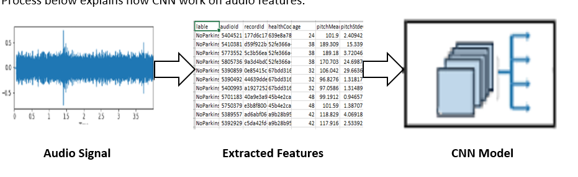
Convolutional Neural Network

Slide 15
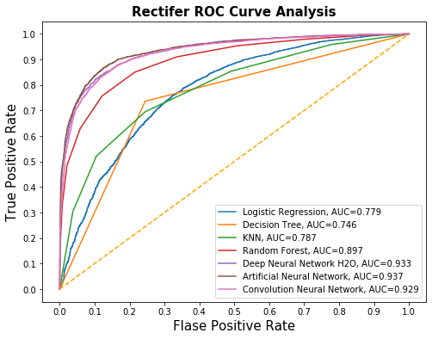
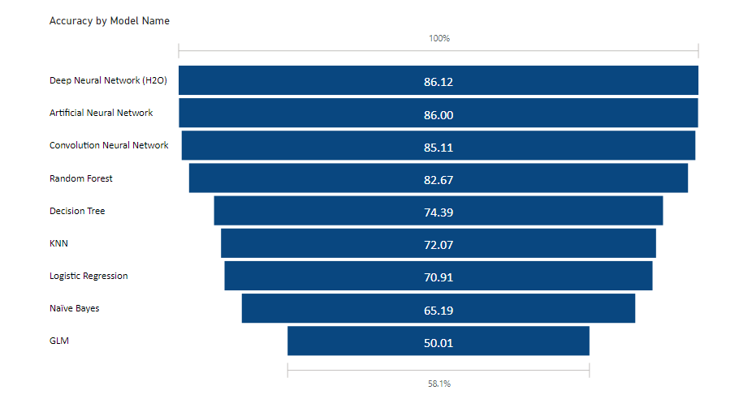
Model Comparison

Slide 16
Conclusion
Deep Learning outperform over traditional models.
Deep Neural Network outperforms over all algorithms with accuracy of 86.12
Research was based on (T. J. Wroge, 2018) and was able to achieve more accuracy with less features.

Slide 17
Future Work
Use other parameters to increase accuracy and reliability of model.
Extend to multiple neurological disorders.

Slide 18
Reference
T. J. Wroge, Y. Ö. C. D. D. S. D. C. A. a. R. H. G., 2018. "Parkinson’s Disease Diagnosis Using Machine Learning and Voice". IEEE Signal Processing in Medicine and Biology Symposium (SPMB), Philadelphia, PA, pp. pp. 1-7 https://ieeexplore.ieee.org/document/8615607

Slide 19

Thank you
Any questions?

